Slide 1
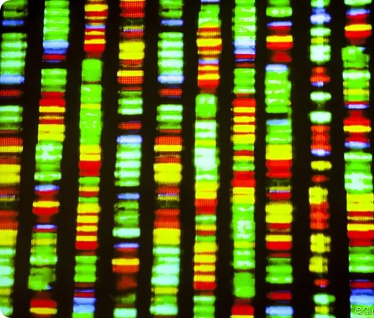
Tutorial 1: Alignments
MAFFT vs. Muscle
By Cameron Calv & Neel Jagad

Slide 2

Sequence Alignments
Arrangement of sequences of DNA, RNA, or protein
Used to identify regions of similarity
Functional Relationship
Structural Relationship
Evolutionary Relationship

Slide 3
MAFFT : Multiple Alignment using Fast Fourier Transform
A
B
C
Accuracy
Highest
Split into 3 categories which exchange speed for accuracy
Progressive Method
Iterative Refinement Method with WSP Score
Iterative Refinement Method with WSP and Consistency Scores
A
C
B
Speed
Lowest

Slide 4
A. The Progressive Method
Create rough distance matrix between sequences using 6-mer similarity
1
Build UPGMA tree for all sequences
2
Align sequences giving highest priority in order of branch number
3

Slide 5
Create rough distance matrix between sequences using 6-mer similarity
1
Build UPGMA tree for all sequences
2
Align sequences giving highest priority in order of branch number
3

Slide 6
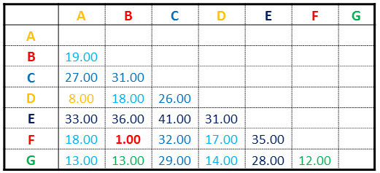
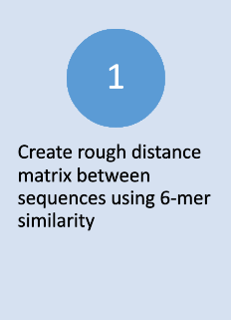
D_{ij}= 1-S_{ij} / min(S_{ii}, S_{jj})
Uses a distance calculated using 6-mer counting
How many times does a sequence of 6 base pairs occur in a row?
Number of shared 6-mers between sequences i and j = S_{ij}
...GGACGTATCTTAGCTAGCGATCA...
CGTATC
ACGTAT
GACGTA
GGACGT

Slide 7
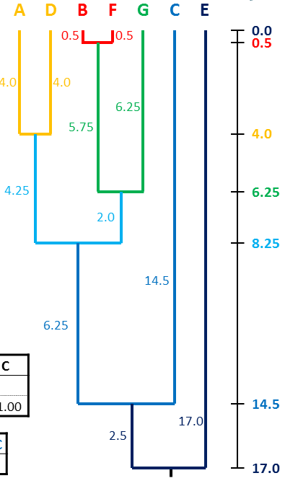

Use the distance matrix to create an UPGMA (Unweighted Pair-Group Method with Arithmetic mean)
Clusters the sequences together based on their relative similarity
Computed using the distance matrix calculate in step 1

Slide 8
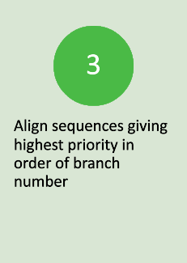
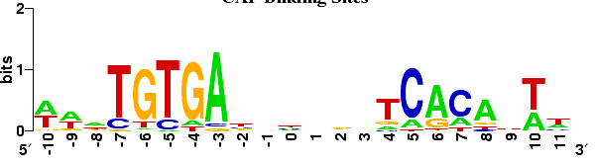
Use the branching order to align your sequences
Sample alignment shown below using WebLogo

Slide 9
A. The Progressive Method (Part II!?)
Re-evaluate distance matrix now using Fast Fourier Transform mapping of base pairs.
1
Re-build UPGMA tree for all sequences
2
Re-align sequences
3
4
5
6

Slide 10
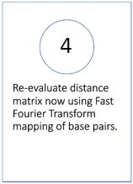

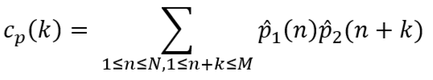
Putting the FFT in MAFFT
Distance matrix recalculated using this cost function:
Where:
Normally this calculation would take O(n²) time, however using the FFT, it can be reduced to O(N log N)
c(k) = c_{v}(k) + c_{p}(k),1

Slide 11
Putting the FFT in MAFFT (continued)
Map base pairs like so and convert 6-mers to complex sequences
G
C
T
A
1
-1
-i
i
...GGACGTATCTTAGCTAGCGATCA...
CGTATC -- (-1, 1, -i, i, -i, -1)
ACGTAT -- (i, -1, 1, -i, i, -i)
GACGTA -- (1, i, -1, 1, -i, i)
GGACGT -- (1, 1, i, -1, 1, -i)

Slide 12
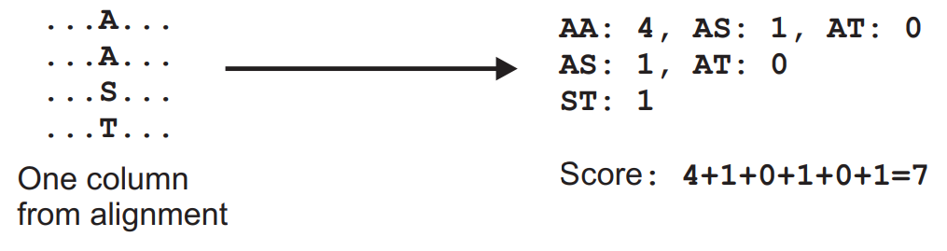
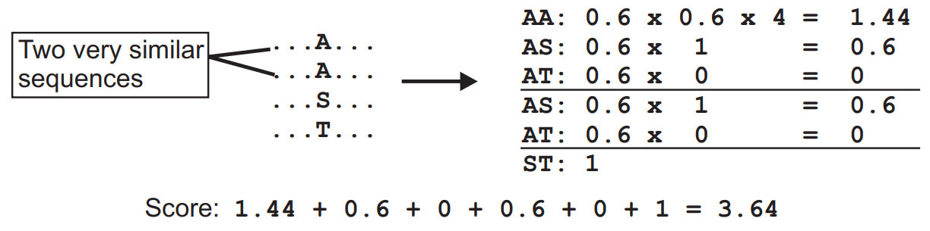
B. The Iterative Refinement Method with the WSP Score
Adds a scoring system to reduce alignment bias
SP (Sum-of-Pairs) Score
WSP (Weighted Sum-of-Pairs) Score

Slide 13
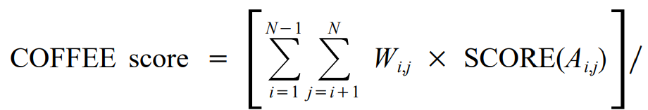
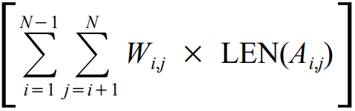
C. The Iterative Refinement Method with the WSP and Consistency Scores
Reduce bias even more with a non-biased scoring system
COFFEE (Consistency based Objective Function For alignmEnt Evaluation)
where:
The greater the score, the better the alignment

Slide 14
MUSCLE (multiple sequence comparison by log expectation)
Elements of the Algorithm
Distance estimation with kmer counting
Progressive alignment with log-expectation Score
Refinement using tree-dependent restricted Partitioning

Slide 15
Methods
Optimizing the sum of pairs score for multiple alignment
Progressive Method

Slide 16
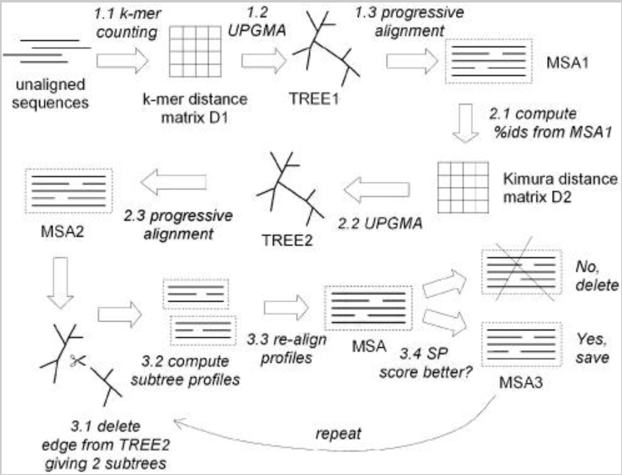
MUSCLE Algorithm

Slide 17
Draft Progressive
Kmer distance is computed for each pair of input sequences which gives a distance matrix
Is a contiguous subsequence of length k
UPGMA is used to cluster the distance matrix to produce a binary tree
Progressive alignment is constructed
At each leaf a profile is constructed from an input sequence
At each internal node, a pairwise alignment is contructed of the two child profiles for that internal node

Slide 18
Improved Progressive
*Because error is usually in the kmer distance measure, MUSCLE re-estimates the tree using the Kimura distance
It takes the tree from draft progressive and computes a distance for each pair of input sequences which gives a distance matrix
UPGMA is used to cluster the distance matrix to produce a new binary tree
Progressive alignment is similar to Draft progressive

Slide 19
Refinement
While not converged or user limited
Taking the tree from Improved Progressive, an edge is chosen and is deleted.
Splits the tree and the profile is recalculated
If the sum of pairs score is improved, it is kept, else it is dropped.

Slide 20
PROs and CONs
MUSCLE
Pros
Can handle medium to large alignments with up to 1000 sequences
Fast
Easy to use
Defaults work for most applications
Cons
Not suitable for sequences with low homology N-terminal and C-terminal extensions
Must have a deep understanding to change parameters
MAFFT
Pros
Large datasets with up to 30,000 sequences
Suitable for sequences with long, low homology N-terminal or C-terminal extensions
Suitable for sequences with long internal gaps (use L-ins-i algorithm)
Cons
Complex
Need to know parameters to use and when to use them

Slide 21
References
C. NOTREDAME, L. HOLM, and D. G. HIGGINS, “COFFEE : an objective function for multiple sequence alignments,” Bioinformatics (Oxford, England), vol. 14, no. 5, pp. 407–422, 1998, doi: 10.1093/bioinformatics/14.5.407.
F. S.-M. Pais, P. de C. Ruy, G. Oliveira, and R. S. Coimbra, “Assessing the efficiency of multiple sequence alignment programs,” Algorithms for molecular biology, vol. 9, no. 1, pp. 4–4, 2014, doi: 10.1186/1748-7188-9-4.
G. E. Crooks, G. Hon, J.-M. Chandonia, and S. E. Brenner, “WebLogo: A Sequence Logo Generator,” Genome research, vol. 14, no. 6, pp. 1188–1190, 2004, doi: 10.1101/gr.849004.
K. Katoh, K. Misawa, K. Kuma, and T. Miyata, “MAFFT: a novel method for rapid multiple sequence alignment based on fast Fourier transform,” Nucleic acids research, vol. 30, no. 14, pp. 3059–3066, 2002, doi: 10.1093/nar/gkf436.
R. C. Edgar, “MUSCLE: multiple sequence alignment with high accuracy and high throughput,” Nucleic acids research, vol. 32, no. 5, pp. 1792–1797, 2004, doi: 10.1093/Nar/Gkh340.
R. J. Edwards, “EdwardsLab,” Dr Richard Edwards - UPGMA Walkthrough, 2016. [Online]. Available: http://www.slimsuite.unsw.edu.au/teaching/upgma/. [Accessed: 23-Apr-2021].
“Multiple alignment program for amino acid or nucleotide sequences,” MAFFT ver.7 - a multiple sequence alignment program. [Online]. Available: https://mafft.cbrc.jp/alignment/software/algorithms/algorithms.html. [Accessed: 21-Apr-2021].
“Multiple alignments: scoring.” [Online]. Available: http://www.cbs.dtu.dk/dtucourse/cookbooks/gorm/transparencies/mulalign/mulalign4.pdf. [Accessed: 23-Apr-2021].
Kimura, Motoo. "The neutral theory and molecular evolution." My Thoughts on Biological Evolution. Springer, Singapore, 2020. 119-138.

